Slide 1

Group 15
Robust Speech
Recognition Project
ELEC E5510
Members:
Xuan Binh (887799)
Tran An (487555)

Slide 2
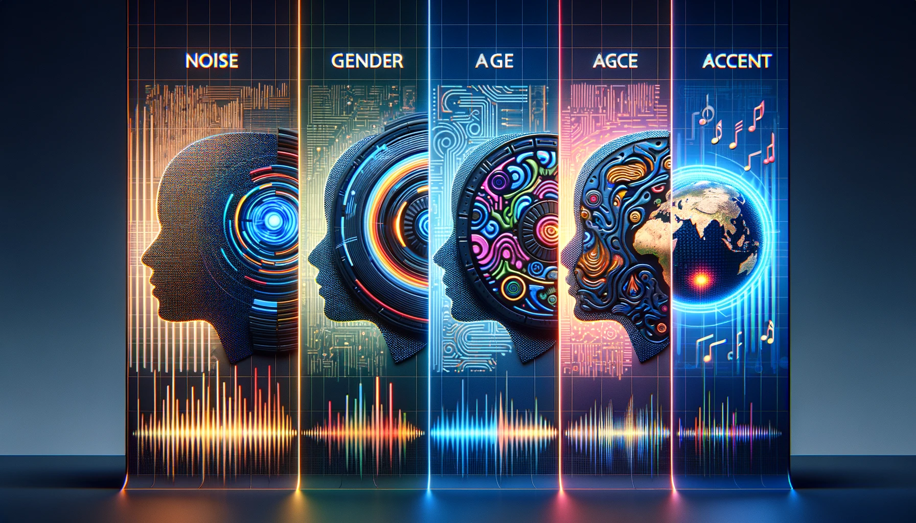
Table of Contents
Introduction
LibriSpeech Dataset
Kaldi Project
General workflow
TDNN-F approach (baseline)
wav2vec approach
n-grams approach
Evaluation results
Discussions
Conclusions

Slide 3
Introduction to Robust Speech Recognition
Defining ASR: Automatic Speech Recognition (ASR) technology translates spoken words into written text, facilitating human-machine communication.
Real-world Complexity: ASR systems often grapple with variables like ambient noise, diverse dialects, and non-standard speech patterns, which can significantly impact accuracy.
Challenges and Solutions: We'll explore common obstacles such as noisy environments, speaker variability, and speaker gender that ASR must overcome.
Benchmarking Robustness: Our analysis includes testing the robustness of ASR systems by Word-Error-Rate to simulate real-life conditions.
Technological Advances: We highlight the techniques like deep neural networks to enhance ASR robustness.
Project Objective: The primary aim is to evaluate and improve ASR system performance, ensuring reliable recognition across different speakers and environments.

Slide 4
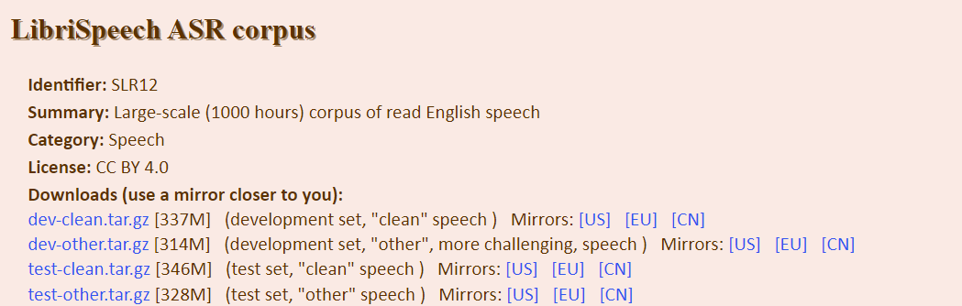
corpus dataset hosted at https://www.openslr.org/12
Reflects real-world complexities: clean and background noise, diverse speakers, and linguistic variations.
Broad range of speakers: variations in accents, tones, and speaking styles.
Metadata only reveals the gender of the speakers
Test-clean: 2620 clean speech utterances from 40 speakers (5.4 hours)
Test-other: 2939 utterances from the same speakers, but with more background noise and other distortions
Dataset Access: Available for download at OpenSLR.

Slide 5
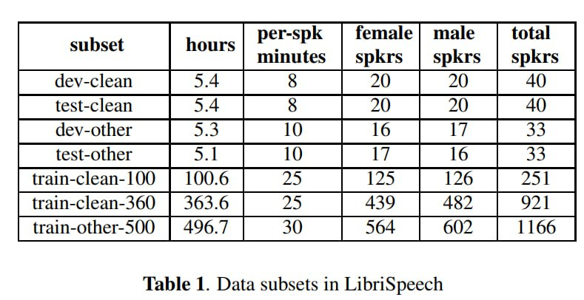
Testing robustness in Librispeech
Robustness to noise/distortions: compare performance test-clean and test-other.
Robustness to speaker variations: compare performance on female and male speeches
[1]

Slide 6
[2]
Official website: https://kaldi-asr.org Github: https://github.com/kaldi-asr/kaldi
Kaldi is a state-of-the-art automatic speech recognition (ASR) C++ toolkit, containing almost any algorithm currently used in ASR systems.
It also contains recipes for training our own acoustic models on commonly used speech corpus such as LibriSpeech, Wall Street Journal(WSJ), Chime, TIMIT, and more. These recipes can also serve as a template for training acoustic models on our own speech data.
Acoustic models are necessary not only for ASR, but also for forced alignment, a technique used to align phonetic transcriptions with the corresponding speech audio, forcing the alignment of the audio with the text at the phoneme level.
Kaldi provides tremendous flexibility and power in training our own acoustic models and forced alignment system.
Notes:
Kaldi is an open-source toolkit for speech recognition written in C++. The goal of Kaldi is to have modern and flexible code that is easy to understand, modify and extend. The tools compile on the commonly used Unix-like systems and on Microsoft Windows.
Researchers on automatic speech recognition (ASR) have several potential choices of open-source toolkits for building a recognition system. Notable among these are: HTK tool
Complete recipes: There are available complete recipes for building speech recognition systems, that work from widely available databases such as those provided by the Linguistic Data Consortium (LDC).
Thorough testing: The goal is for all or nearly all the code to have corresponding test routines. The main intended use for Kaldi is acoustic modeling research The chief advantage versus HTK is modern, flexible, cleanly structured code

Slide 7
General workflow of Kaldi
Lorem 2
2. Acoustic Model Training
Lorem 3
3. Audio Alignment & Contextual Modeling
Lorem 4
Lorem 1
Refined Model Training
Lorem 5
1. Transcript Preparation & Feature Extraction
Final Alignment & Model Optimization
- Obtain accurate transcripts of the speech data.
- Format transcripts following Kaldi's requirements
- Extract acoustic features from the audio using MFCC
- Train the initial acoustic models using target framework, such as HMM-DNN or TDNN-F
- Incorporate contextual information sets later stage for more complex models.
- Force align audio with the initial acoustic models to optimize parameter estimation.
- Training monophone/ triphone models that consider the phoneme context, using phonetic decision trees
- Iterate the process of alignment and training
- Incorporating advanced techniques like LDA-MLLT or SAT to refine the triphone models.
- Perform final alignments using SAT techniques like FMLLR to fine-tune the acoustic models.
- This stage ensures the models are robust and can generalize well across different speakers and contexts.
Notes:
Speaker Adaptive Training (SAT) is a technique in speech recognition where the acoustic models are trained to be robust to variations in speaker characteristics. SAT involves adapting the training data to a canonical form using speaker-specific transformations. These transformations are typically estimated for each speaker and applied to the acoustic features before model training. This process helps the model learn patterns that are more general and not specific to the voice or style of the speakers in the training set, thus improving the model's performance on a diverse range of speakers.
Linear Discriminant Analysis (LDA): This technique is used to reduce the dimensionality of feature vectors while preserving as much of the class discriminatory information as possible. LDA projects the high-dimensional feature vectors into a lower-dimensional space in a way that maximizes the distance between different classes (such as different phonemes in speech).
Maximum Likelihood Linear Transform (MLLT): MLLT, sometimes also known as STC (Semi-Tied Covariance Transform), is applied after LDA. It further transforms the feature space to make the features more Gaussian-like, which often helps in GMM-based ASR systems. This transformation is learned in a way that maximizes the likelihood of the observed data, hence the name.
When used together, LDA-MLLT can improve the performance of ASR systems by providing more discriminative and model-friendly features. These techniques are often used with other feature processing and model training steps in advanced ASR systems.
FMLLR stands for Feature-space Maximum Likelihood Linear Regression. It's a technique used in speech recognition to adapt acoustic models to specific speakers or environments. FMLLR works by transforming the acoustic feature space to better match the characteristics of the current speaker or acoustic conditions. This transformation is computed in a way that maximizes the likelihood of the observed data given the acoustic model. FMLLR can significantly improve the performance of speech recognition systems, especially in situations where there's a mismatch between the training data and the actual usage environment or speaker characteristics.

Slide 8
Tested models
TDNN-F (Time Delay Neural Network with Factored parameters)
Wav2vec 2.0 (Self-supervised wave to vector representation)
Wav2vec 2.0 base
Wav2vec 2.0 base + 4-gram Language model (LM)

Slide 9
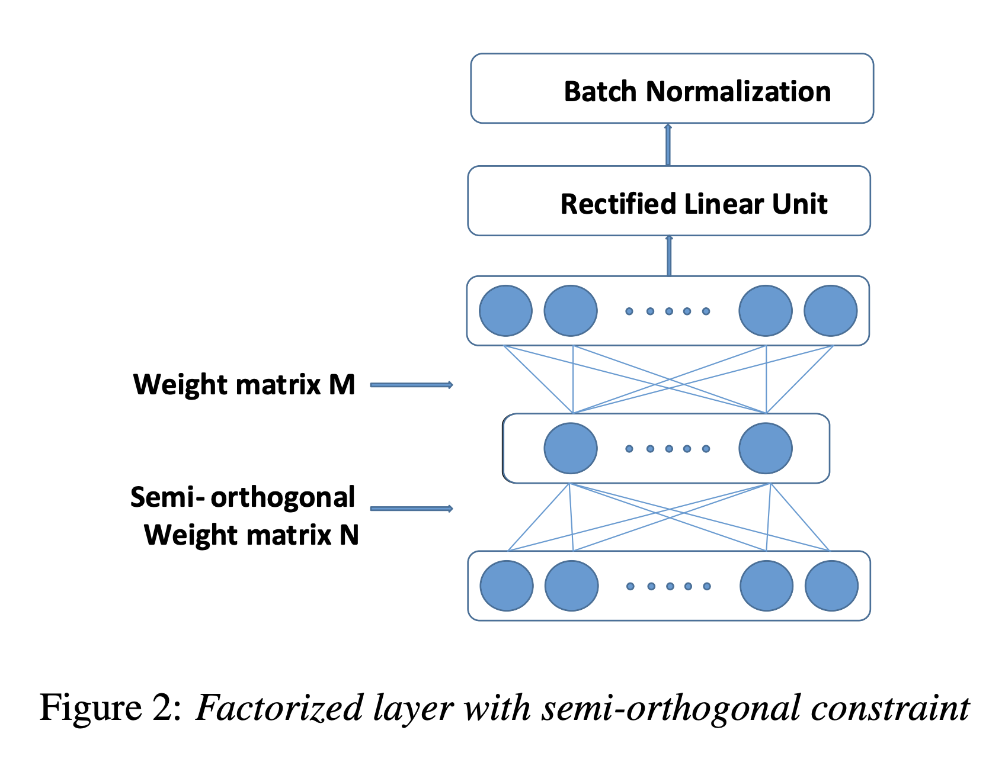
TDNN-F model
Temporal Modeling of audio sequence
Parameter Efficiency: The 'Factored' aspect of TDNN-F uses a low-rank matrix factorization approach
Semi-Orthogonality: semi-orthogonal constraints on matrix factors
Performance: TDNN-F models typically outperform standard TDNNs by achieving better accuracy with fewer parameters.
Integration: TDNN-F is often used in Kaldi's chain models with LF-MMI training
[3]
Notes:
Time Delay Neural Networks (TDNNs), also known as one dimensional Convolutional Neural Networks (1-d CNNs), are
an efficient and well-performing neural network architecture for speech recognition. We introduce a factored form of TDNNs
(TDNN-F) which is structurally the same as a TDNN whose layers have been compressed via SVD, but is trained from a random start with one of the two factors of each matrix constrained to be semi-orthogonal.
The input to a TDNN-F is a sequence of acoustic feature vectors extracted from the audio signal. These could be Mel-frequency cepstral coefficients (MFCCs) or filter bank coefficients
The output is a sequence of probabilities over the possible phonetic states. This output could be fed into further layers or combined with a Hidden Markov Model (HMM) to determine the most likely sequence of spoken words.
Temporal Modeling: TDNN-F is designed to capture the temporal context in sequential data like audio
Parameter Efficiency: The 'Factored' aspect of TDNN-F uses a low-rank matrix factorization approach, reducing the number of parameters and computational cost.
Semi-Orthogonality: It imposes semi-orthogonal constraints on matrix factors, ensuring that the weight matrices do not stray far from orthogonality
Performance: TDNN-F models typically outperform standard TDNNs by achieving better accuracy with fewer parameters.
Integration: TDNN-F is often used in Kaldi's chain models with Lattice Free Maximum Mutual Information (LF-MMI) training, which helps minimize Word Error Rate.
Architecture:
Temporal Context: TDNNs take into account the sequential nature of the input data by applying the same set of weights across different time steps, capturing patterns over time.
Layer Structure: They consist of multiple layers, each designed to process different temporal resolutions. Early layers might focus on short-term patterns, while deeper layers capture longer-term dependencies.
Weight Sharing: Similar to convolutional layers in image processing, TDNNs use weight sharing to apply the same transformation across different temporal segments, which is useful for detecting phonetic features that can occur at different times.
Splicing: Inputs to the layers are often "spliced" together, meaning that for each time step, the network considers not just the current input but a window of surrounding inputs.
Loss Function:
TDNNs are commonly trained using standard loss functions for classification tasks, like cross-entropy loss when used for phoneme classification.
For speech recognition, they can be trained using the Connectionist Temporal Classification (CTC) loss or Lattice-Free Maximum Mutual Information (LF-MMI) to optimize sequence-level objectives.
Potential Questions:
How does a TDNN handle variable-length inputs?
TDNNs can process variable-length sequences by design, as they apply the same weights regardless of sequence length.
What makes TDNNs suitable for speech recognition?
Speech signals have temporal dynamics, and TDNNs are designed to capture such time-related patterns efficiently.
How does TDNN differ from RNN or LSTM?
TDNNs use fixed temporal contexts and don’t have recurrent connections, while RNNs and LSTMs use recursive loops to process sequences, which can capture longer dependencies but are more computationally intensive.
Can TDNNs handle real-time processing?
Yes, TDNNs can be used for real-time processing as they can make predictions based on fixed windows of the audio signal.
What are the challenges with TDNNs?
One challenge is choosing the right context window size to balance between computational efficiency and the ability to capture relevant temporal dependencies.
How do TDNNs achieve translation invariance?
TDNNs apply the same weights across time steps, which makes the detection of features invariant to their position in time.
Can TDNNs be used for other types of data besides audio?
Yes, TDNNs can be applied to any sequence data where temporal patterns are important, such as video or sensor signals.
TDNNs, particularly when enhanced as TDNN-Fs, have proven effective in various ASR systems, and continue to be an area of active research and application in the field of speech processing.

Slide 10
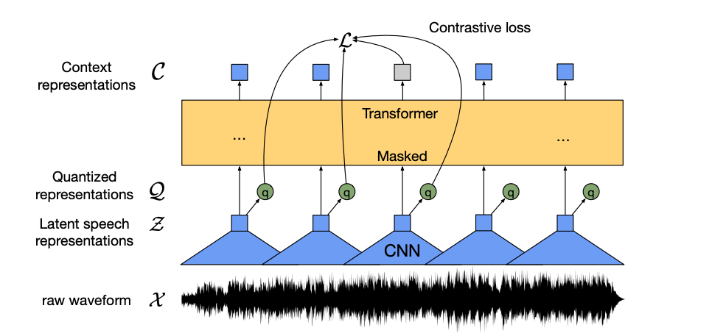
Wav2Vec 2.0: Pre-training
Learning powerful representations from speech audio alone followed by fine-tuning on transcribed speech can outperform the best semi-supervised methods while being conceptually simpler [4]

Slide 11
Wav2Vec 2.0: Pre-training
Notes:
The feature encoder’s job is to reduce the dimensionality of the audio data, converting the raw waveform into a sequence of feature vectors Z₀, Z₁, Z₂, …, Z_{T} each 20 milliseconds. Its architecture is simple: a 7-layer convolutional neural network (single-dimensional) with 512 channels at each layer.

Slide 12
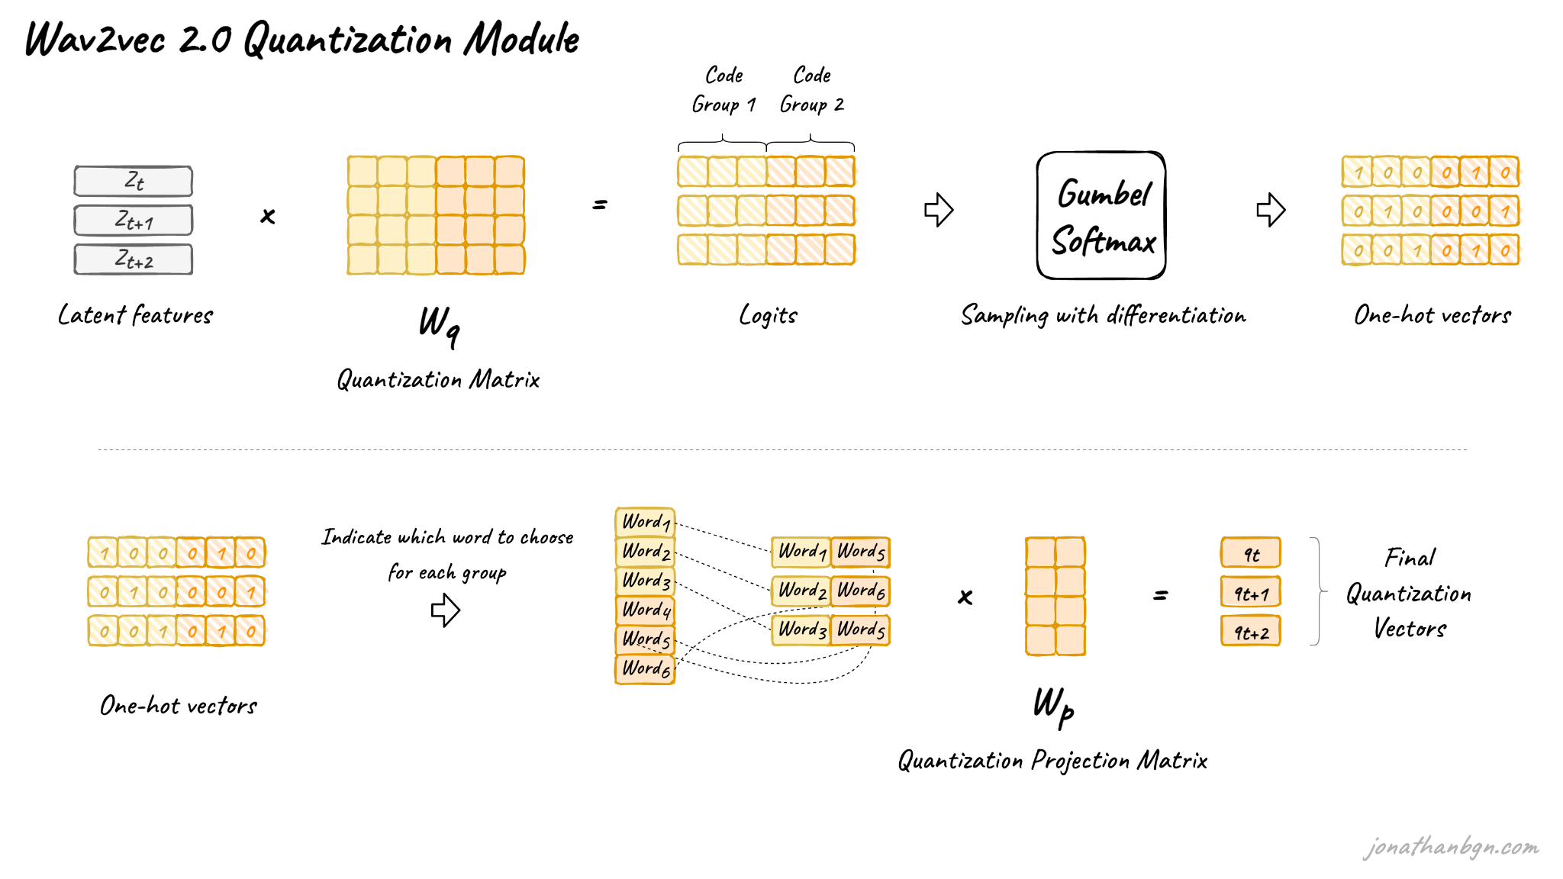
Wav2Vec 2.0: Pre-training
Notes:
The latent features are multiplied by the quantization matrix to give the logits: one score for each of the possible codewords in each codebook. The Gumbel-Softmax trick allows sampling a single codeword from each codebook, after converting these logits into probabilities. It is similar to taking the argmax except that the operation is fully differentiable. Moreover, a small randomness effect, whose effect is controlled by a temperature argument, is introduced to the sampling process to facilitate training and codewords utilization.

Slide 13
Wav2Vec 2.0: Pre-training
Notes:
wav2vec 2.0 masks the speech input in the latent space and solves a contrastive task defined over a quantization of the latent representations which are jointly learned [3]

Slide 14
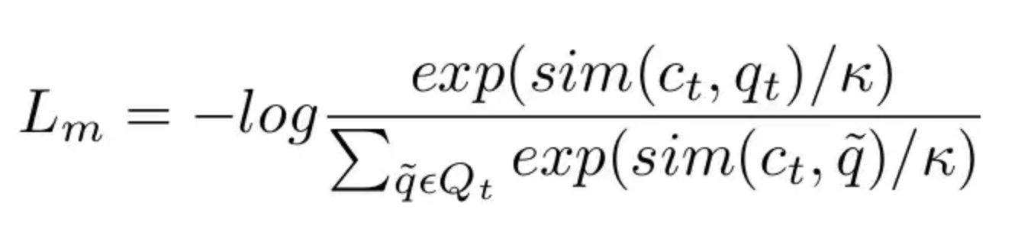
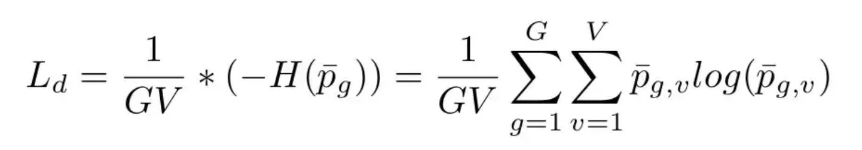
Wav2Vec 2.0: Pre-training
Contrastive loss:
Diversity loss:
Notes:
The final context vectors then go through the last projection layer to match the dimension of the quantized speech units Q_{t}. For each masked position, 100 negative distractors are uniformly sampled from other positions in the same sentence. The model then compares the similarity (cosine similarity) between the projected context vector C’_{t} and the true positive target Q_{p} along with all negative distractors Q_{ñ}. The contrastive loss then encourages high similarity with the true positive target and penalizes high similarity scores with negative distractors.
During pre-training, another loss is added to the contrastive loss to encourage the model to use all codewords equally often. This works by maximizing the entropy of the Gumbel-Softmax distribution, preventing the model to always choose from a small sub-group of all available codebook entries. You can find more details in the original paper.

Slide 15
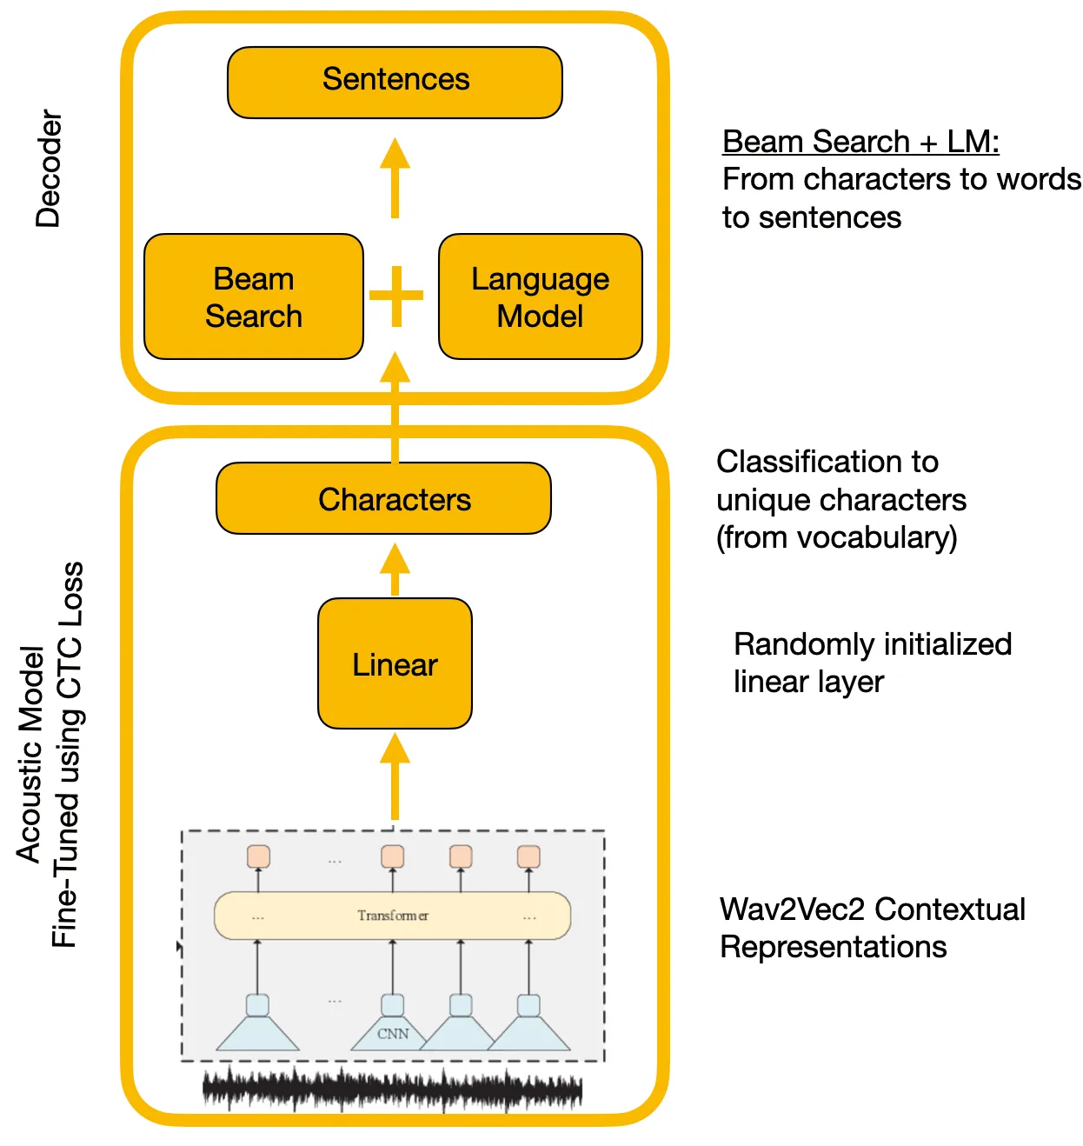
Wav2Vec 2.0: Fine tuning

Slide 16
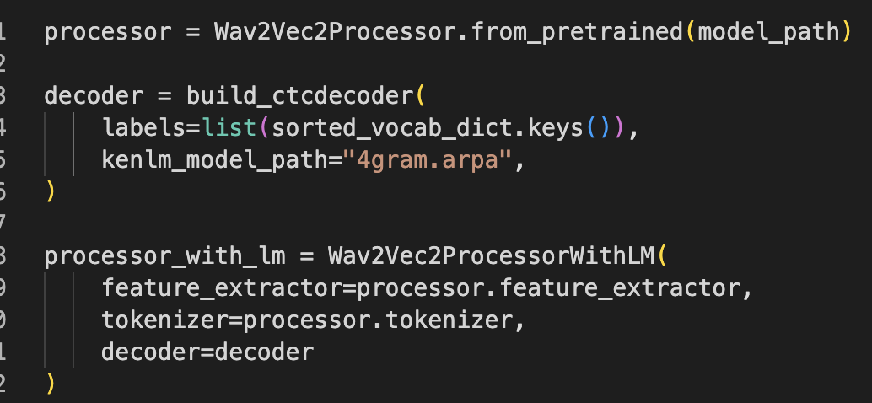
Wav2Vec 2.0 + n-gram LM

Slide 17
Evaluation results
The TDNN-F model is tested on the LibriSpeech dataset as the baseline
WER | test-clean average | test-other average
TDNN-F 3 grams | 5.28% | 12.52%
WER | test-clean male | test-other male | test-clean female | test-other female
TDNN-F 3 grams | 5.13% | 13.84% | 5.40% | 11.16%

Slide 18
Evaluation results
wav2vec and n-gram models are tested on the LibriSpeech dataset
WER | test-clean average | test-other average
Wav2vec 2 | 3.386% | 8.568%
Wav2vec 2 + 4-gram | 2.601% | 6.473%
WER | test-clean male | test-other male | test-clean female | test-other female
Wav2vec2 | 3.247% | 9.582% | 3.516% | 7.579%
Wav2vec2 4gram | 2.337% | 7.264% | 2.850% | 5.642%

Slide 19
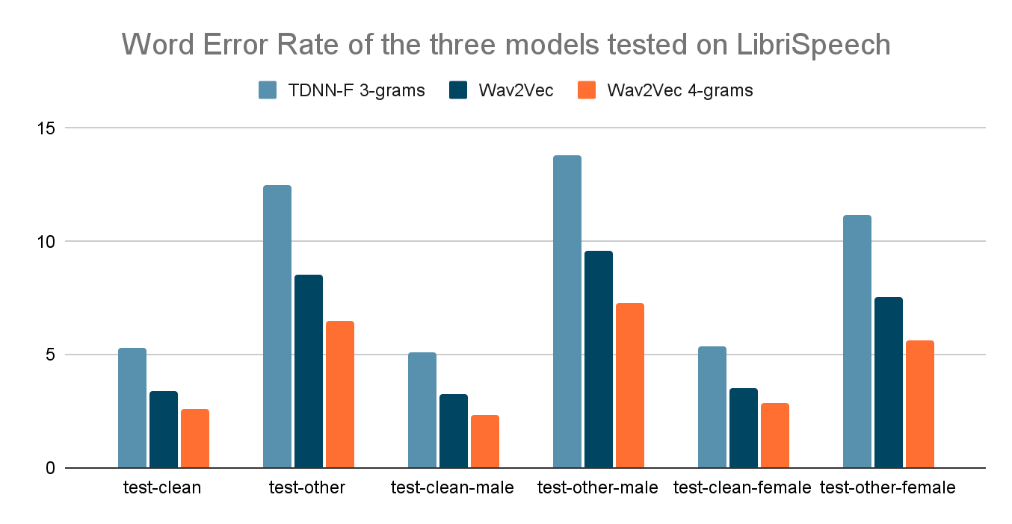
Discussions
Model performance from best to worst
1. Wav2Vec 4-grams
2. Wav2Vec (no LM)
3. TDNN-F
WER on female dataset is better than WER on the male dataset

Slide 20
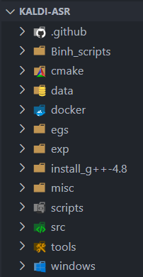
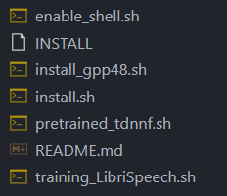
Conclusions
Wav2vec2 + 4-gram model performs best results in all of the sub-datasets compared to Wav2vec2 and TDNN-F models
Better performance in female speeches than male speeches.
Worse testing performance on noisy environment than clean speech on LibriSpeech
Kaldi is a powerful tool for researchers in ASR that supports all ASR stages and diverse models, albeit a steep learning curve
We managed to install Kaldi project on the Windows Linux Subsystem, which is a lengthy process due to many dependencies
Basic models are covered in Kaldi like HMM-GMM (Speaker Adaptive Training) to advanced models like NNLM toolkit

Slide 21
References
[1] Panayotov, V., Chen, G., Povey, D., & Khudanpur, S. (2015). Librispeech: An ASR corpus based on public domain audio books. In 2015 IEEE International Conference on Acoustics, Speech and Signal Processing (ICASSP) (pp. 5206-5210). IEEE.
[2] Povey, D., Ghoshal, A., Boulianne, G., et al. (2011). The Kaldi Speech Recognition Toolkit. In IEEE 2011 Workshop on Automatic Speech Recognition and Understanding. IEEE Signal Processing Society
[3] Povey, D., Cheng, G., Wang, Y., Li, K., Xu, H., Yarmohammadi, M., Khudanpur, S. (2018) Semi-Orthogonal Low-Rank Matrix Factorization for Deep Neural Networks. Proc. Interspeech 2018, 3743-3747, doi: 10.21437/Interspeech.2018-1417
[4] Baevski, A., Zhou, H., Mohamed, A., & Auli, M. (2020). wav2vec 2.0: A Framework for Self-Supervised Learning of Speech Representations. ArXiv, abs/2006.11477.

Slide 22
Question and Answers? (Please don’t be hard 😢)

